Slide 1
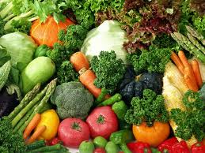
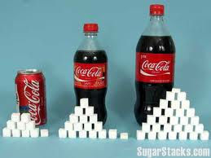
Metabolic Diseases
Lesson 4.2
‘Good’ vs. ‘Bad’ food -
How do we tell?

Slide 2
Do Now
Yesterday we learned about how scientists develop questions.
How do scientists answer these questions?

Slide 3
Study Types
Meta-Analysis
Randomized Controlled Trials
Observational Studies
Animal Studies
In Vitro (Cell Culture) Studies

Slide 4


What might be a caveat of experiments with cell cultures or animals
= or ≠
?
= or ≠
?

Slide 5
Study types limit conclusions
Meta-Analysis
Randomized Controlled Trials
Observational Studies
Animal Studies
Do animals respond like humans?
In Vitro (Cell Culture) Studies
Do cells respond like animals?
Always need to confirm in humans!

Slide 6
Common types of human studies
Observational
Case series: Single person or small group.
Migrant studies: Looks at changes as people migrate between countries
Cohort studies: Looks at subjects at risk; starts with a healthy population and follows it over time.
Case control studies: Compares people with a disease with healthy populations.
Observational
Case series: Single person or small group.
Migrant studies: Looks at changes as people migrate between countries
Cohort studies: Looks at subjects at risk; starts with a healthy population and follows it over time.
Case control studies: Compares people with a disease with healthy populations.

Slide 7
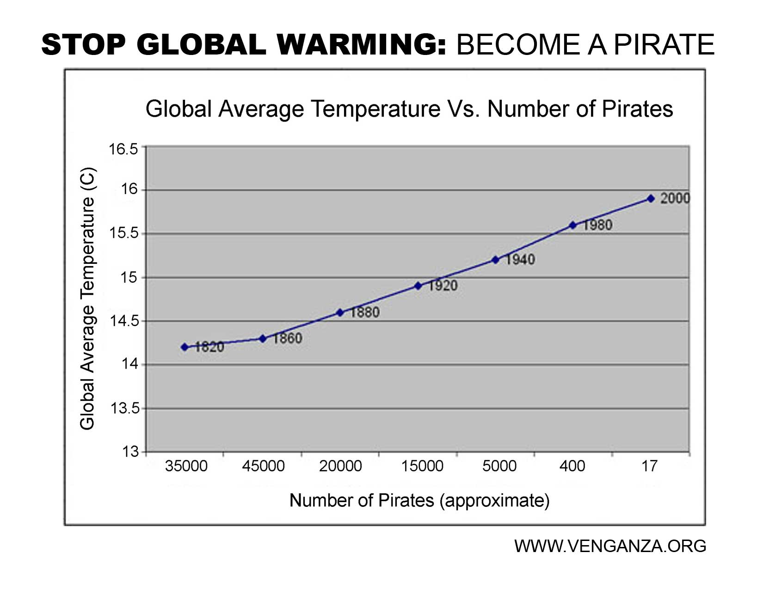
What is a caveat of observational studies?
They can only show correlations!
Is the correlation related to the cause?

Slide 8
Study types limit conclusions
Meta-Analysis
Randomized Controlled Trials
Observational Studies
Is the correlation related to the cause?
Need to confirm with randomized
controlled trials!
Animal Studies
Do animals respond like humans?
In Vitro (Cell Culture) Studies
Do cells respond like animals?

Slide 9
Common types of human studies
Interventional
Randomized control: Subjects are randomly assigned to the experimental or the control group.
Double blind: Subjects or experimenters are not aware who is in the experimental or control group.

Slide 10
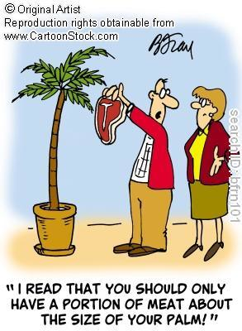
What is a caveat of interventional studies?
Do the test subjects follow directions?

Slide 11
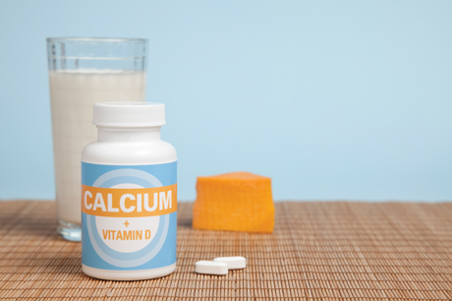
Another major caveat of studying nutrients rather than foods
A nutrient may need other nutrients to have an effect. For example, you need vitamin D to absorb calcium.

Slide 12
Study types limit conclusions
Meta-Analysis
Randomized Controlled Trials
Only method that can show causation*
Observational Studies
But hard to do for human nutrition
Is the correlation related to the cause?
Animal Studies
Do animals respond like humans?
In Vitro (Cell Culture) Studies
Do cells respond like animals?

Slide 13
Study types limit conclusions
Are results reproducible between groups?
Meta-Analysis
Must confirm with numerous studies
Randomized Controlled Trials
Only method that can show causation*
Observational Studies
Is the correlation related to the cause?
Animal Studies
Do animals respond like humans?
In Vitro (Cell Culture) Studies
Do cells respond like animals?

Slide 14
Dietary suggestions are often made before they are validated by enough interventional studies.
This may be why ‘good’ and ‘bad’ foods are always changing!

Slide 15
The three main types of bias
Selection bias: Occurs when subjects in a study are selected non-randomly.
Confounding variables: Occurs when a third variable exists that correlates with both the independent and dependent variable.
Information bias: Occurs when one variable is a systematically over- or under-assessed.

Slide 16

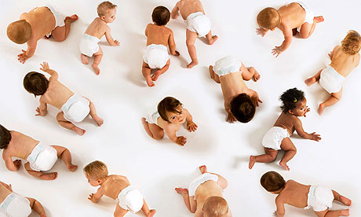
Selection bias is a problem in all studies that aren’t randomized
Occurs when subjects in a study are selected as a result of a third variable that wasn’t or couldn’t be measured.
≠
- All people, but not equivalent people!

Slide 17
Confounding variables can be a problem in observational studies
Occurs when a third variable exists that correlates with both the independent and dependent variable.
Alcohol consumption is associated with lung cancer.
  Does this mean that alcohol causes lung cancer?
  Or do smokers consume more alcohol?

Slide 18
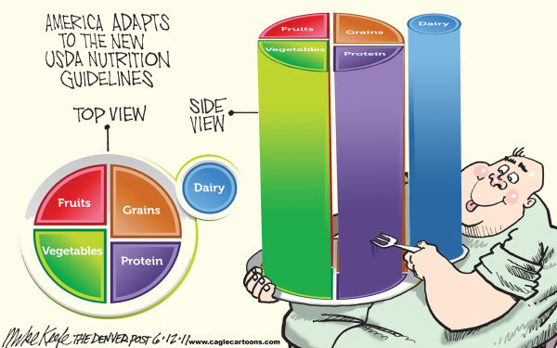
Information bias can always be a problem
Occurs when one variable is a systematically over- or under-assessed.
You ask: How many servings of carbohydrates did you eat today?
  Do people tell the truth?
  Are they always accurate?

Slide 19
Wrap Up
If a human nutrition study can’t prove causation what can you conclude?
How does this relate to how you would respond to the constant changes in dietary recommendations?

Slide 20
Homework
  Select a question from your Lesson 4.1 homework and describe how you would answer that question using one of the study types presented today.
  What population would you study?
  What types of bias would you need to account for?

